Slide 1
EEE 686 Homework 5 -Modifications
Yi Chen
3/29/2020

Slide 2
Control objectives
Implement the modifications:
Deadzone
Sigma
Projection
Tested with step input / pulse train with excitation
Professor’s note: You should not increase the dead-zone too much. Then you will be admitting very poor controllers. Similar for sigma. Your projection does not work. Once you hit it, there is no way back.

Slide 3
Input Perturbation
Max: 0.1, Min: -0.1, Sampling time: 0.1s

Slide 4
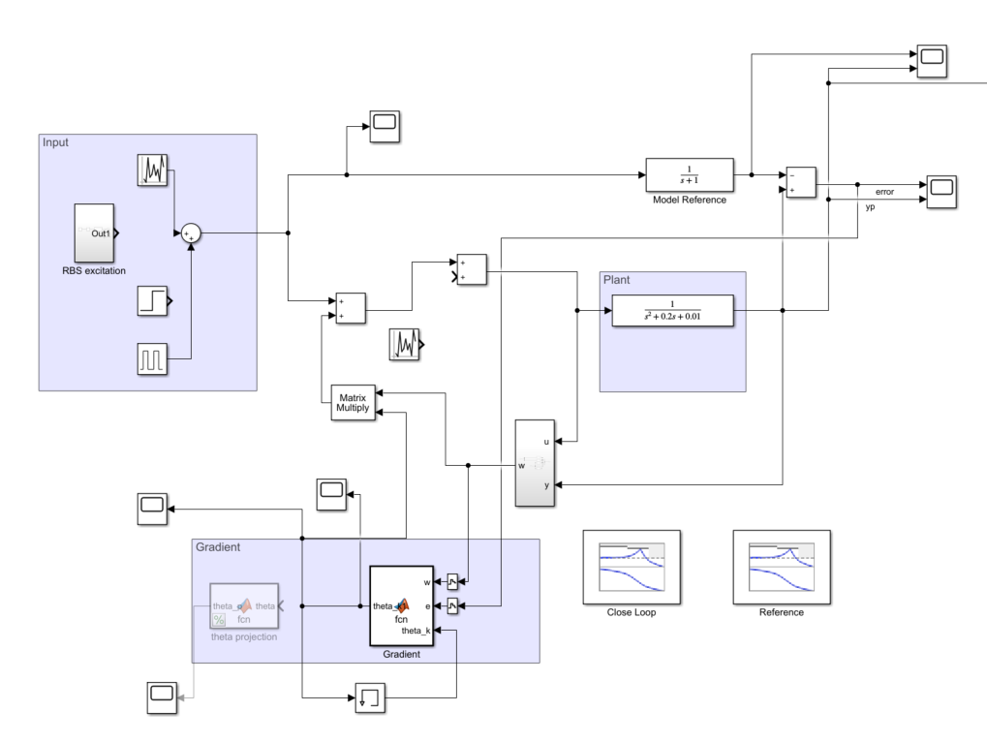
MRAC -System setup
Input with perturbation / excitation
Reference model: 1/(s+1)
We are modifying gradient algorithm in this homework.
We use a pulse train input to see how well the plant converges to reference model.
Discrete gradient

Slide 5
MRAC –P1 -Deadzone
Deadzone: delta = 0.1

Slide 6
MRAC –P1 –Deadzone–More perturbation
• Introduce a bigger perturbation [-5, 5] at t=150s

Slide 7
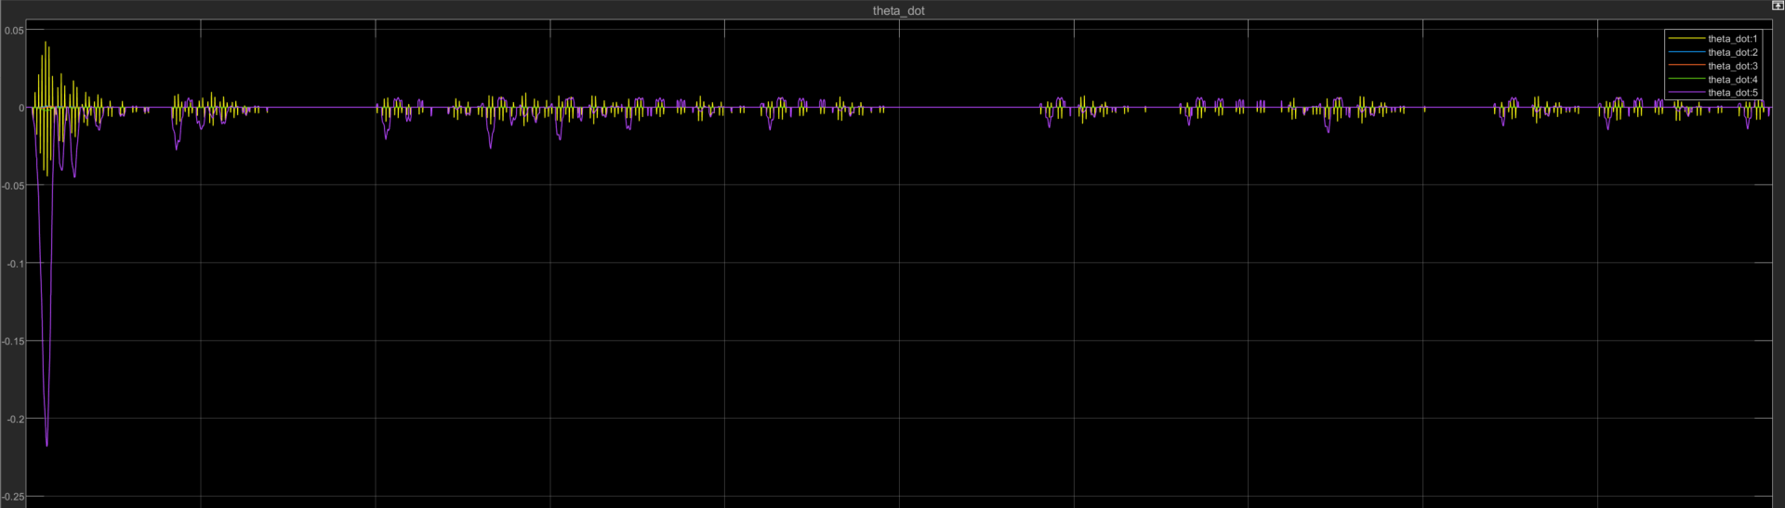
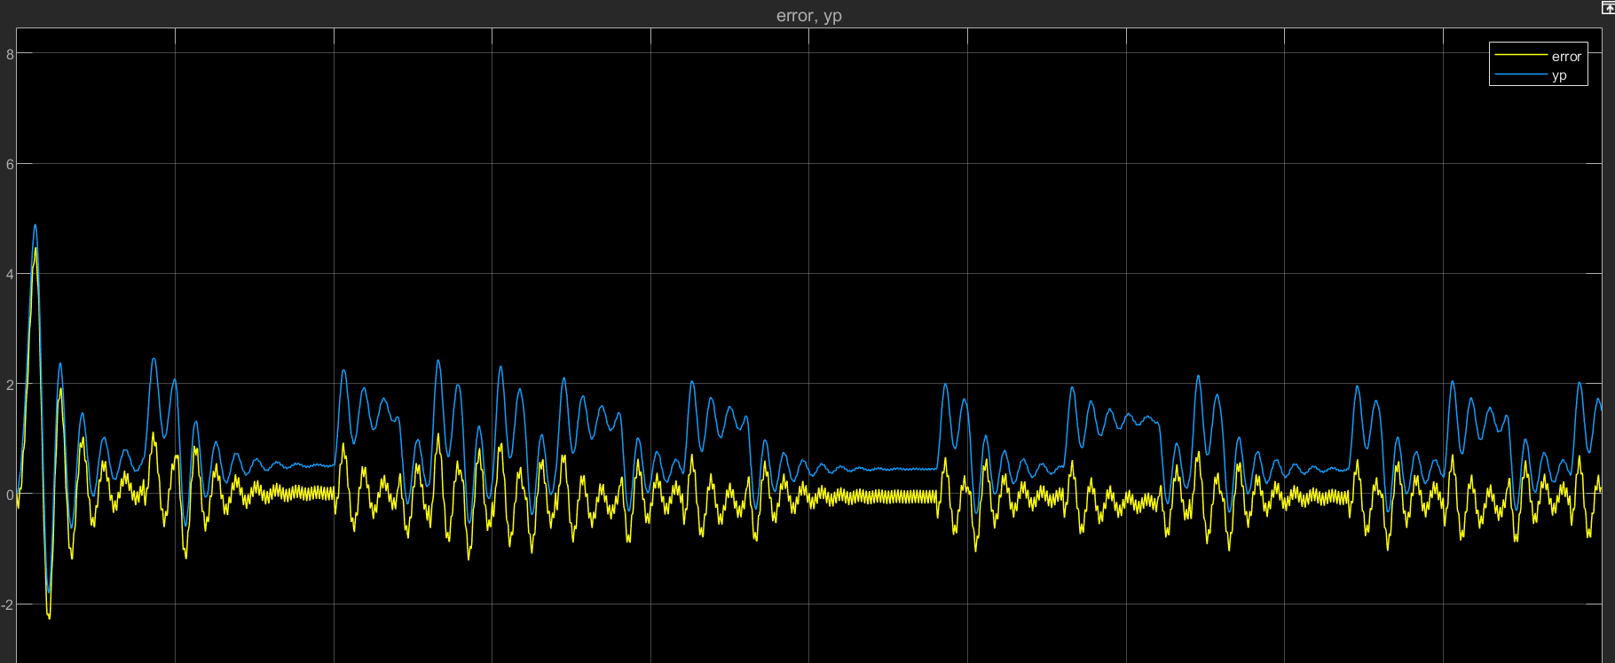
MRAC –P1 –Deadzone–signal disturbances
In this trial we included RBS signal excitation
Delta is set to 0.3
We can see the deadzone in action from theta dot graph
Input is a pulse train signal + excitation
System output(blue) and output error(yellow
Theta_dot for MRAC (gradient)

Slide 8
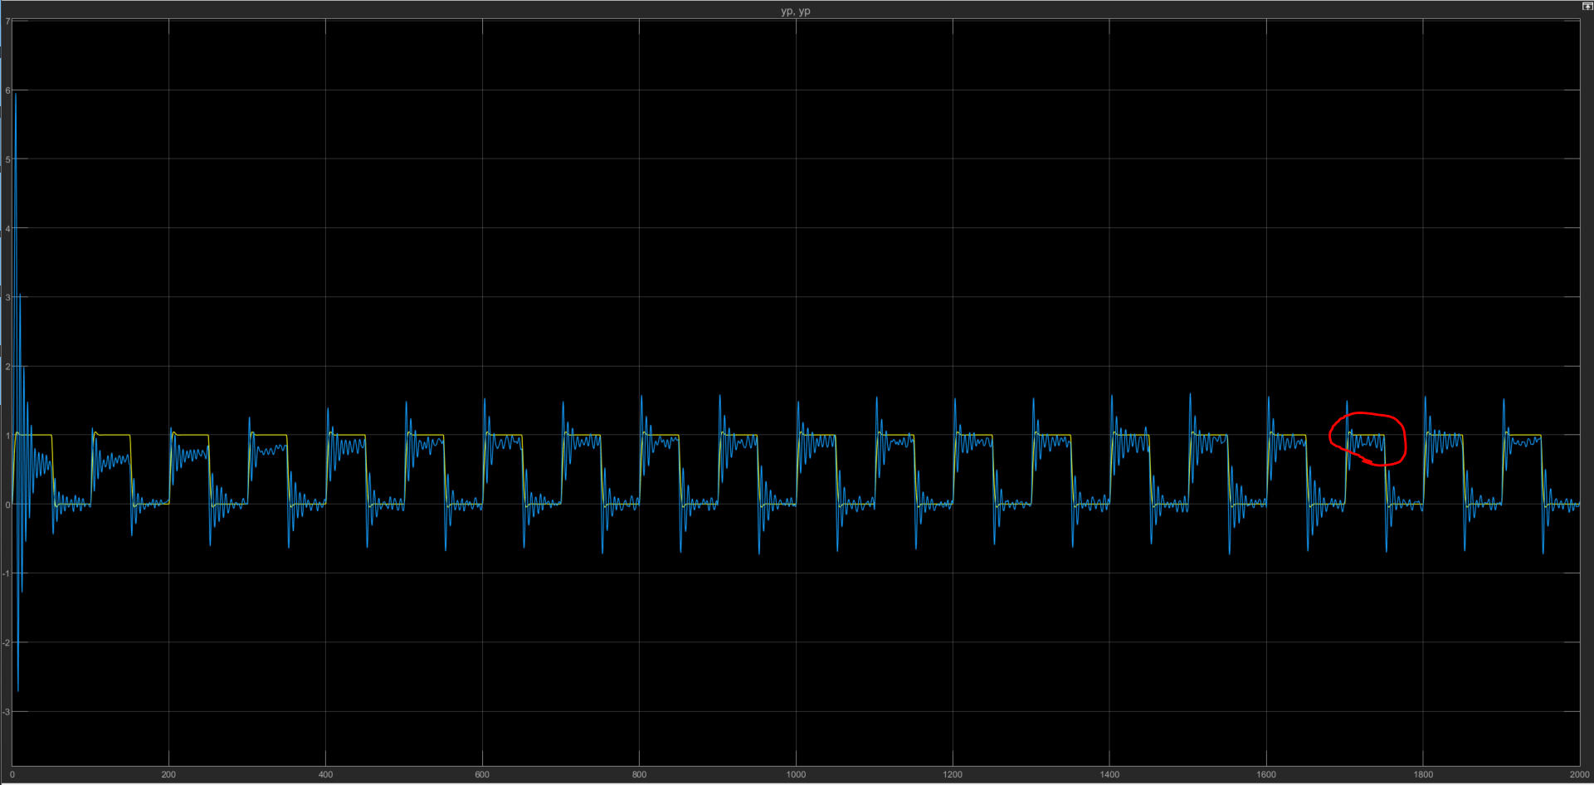
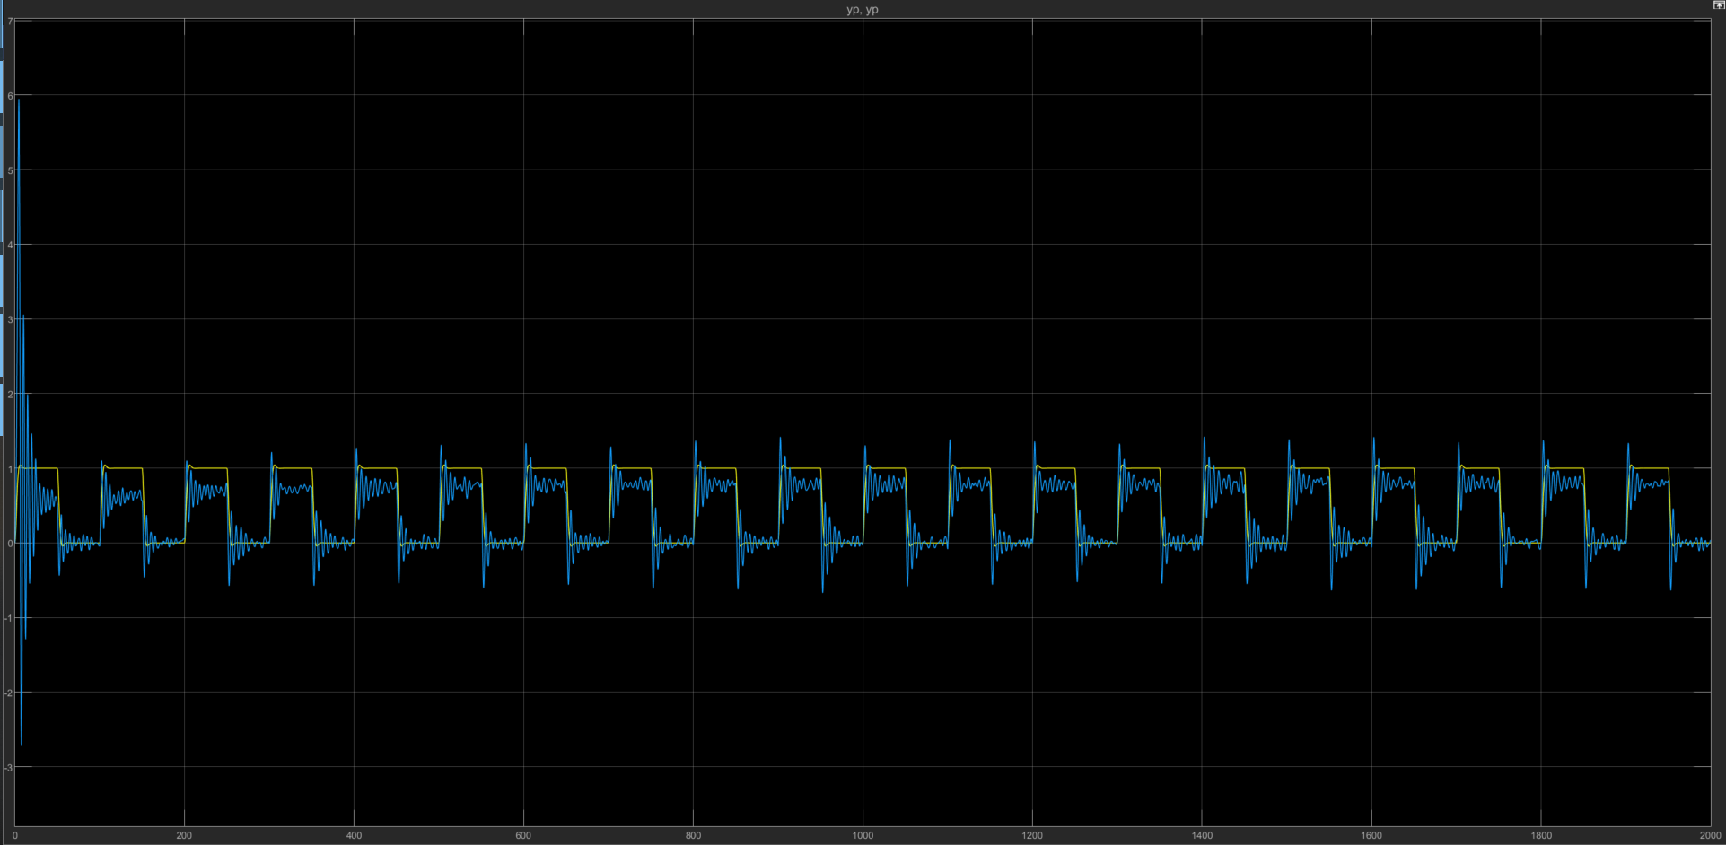
Comparing different DZ settings (delta)
← We can see that the error is reduced as the delta is reduced such that the deadzone kicks in later.
Fixed MRC vs MRAC w/ DZ
Delta = 0.1
Fixed MRC vs MRAC w/ DZ
Delta = 0.3
What I wanted to see here is that how much difference would the delta make in terms of system output compared to the ideal system.

Slide 9
MRAC –P1 –Sigma
System output(blue) and output error(yellow) for MRAC (gradient)

Slide 10
MRAC –P1 –Projection – first attempt
•My attempt: if theta is over a threshold, then stop updating theta dot.
Parameter for MRAC (gradient)

Slide 11
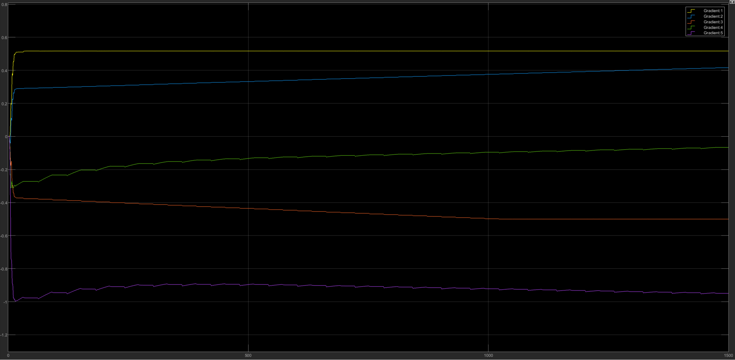
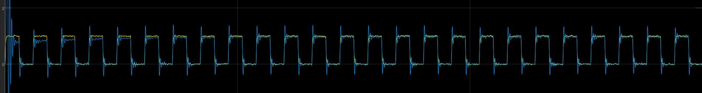
Updated Projection Modification
Instead of previously using continuous time where I modify the theta_dot when the parameters are outside of a boundary, I used discrete system in this case so that we have direct access to the theta for projection.
Parameters are projected individually if they go outside of the boundary set. They are projected to the closest boundary, i.e. theta_max if they exceeds the max value.
Parameter for MRAC (gradient)
Reference model vs Plant output for MRAC (gradient)

Slide 12
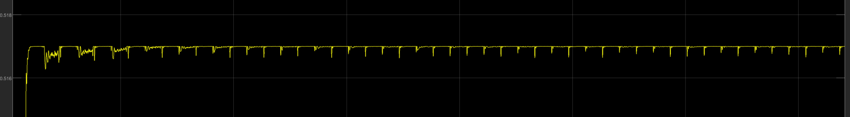
Updated projection - continued
Theta_star: [0.017 0.078 0 -0.01 -1]
Theta_min: [-0.1 -0.1 -0.5 -0.31 -1.8]
Theta_max: [0.517 0.778 0.1 0.09 2]
Below is the enlarged view of the bounded parameter (theta 1)
We can see that the perturbation in input causes the parameter to spike a little then become bounded again.
Theta_1

Slide 13
Summary
The modifications are meant for improving robustness when input perturbation is present.
Sigma modification seems to create an offset compare to the deadzone.
Selecting appropriate parameter set to project onto is important as poor design could disrupt the transient response of the system.

